Slide 1

Artificial Intelligence (CSE 412)
Topic – 2: Threshold Logic and Perceptron
Department of CSE
Daffodil International University

Slide 2
Topic Contents
Overview
Applications
History

Slide 3
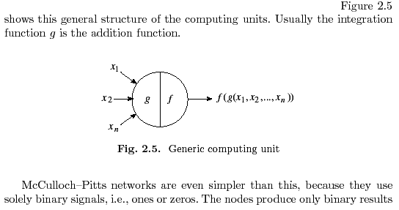

Threshold Logic

Slide 4
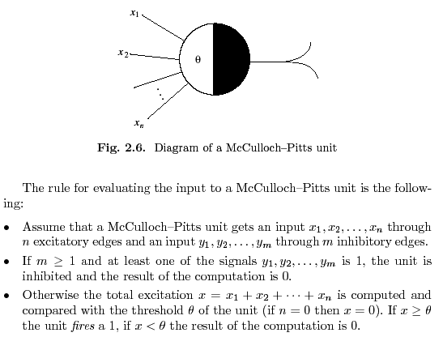
Threshold Logic

Slide 5
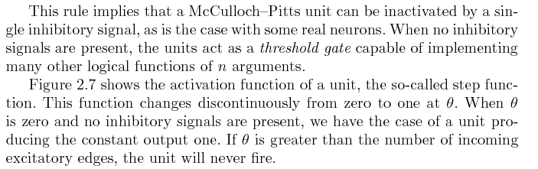
Threshold Logic

Slide 6
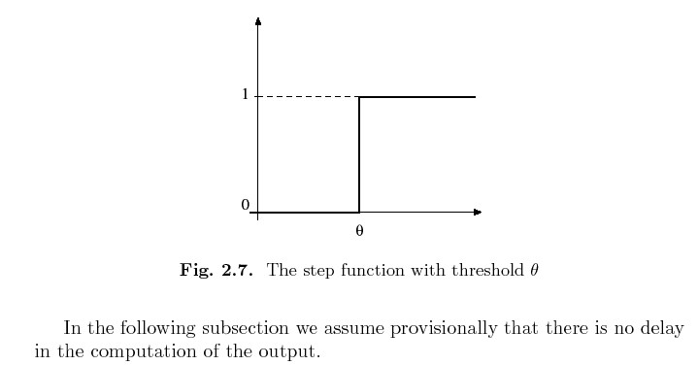
Threshold Logic

Slide 7
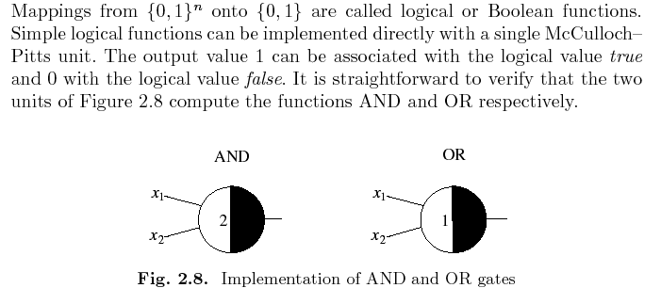
Threshold Logic

Slide 8
Threshold Logic
A single unit can compute the disjunction or the conjunction of n arguments as is shown in Figure 2.9, where the conjunction of three and the disjunction of four arguments are computed by two units, respectively.
The same kind of computation requires several conventional logic gates with two inputs.
It should be clear from this simple example that threshold logic elements can reduce the complexity of the circuit used to implement a given logical function.

Slide 9
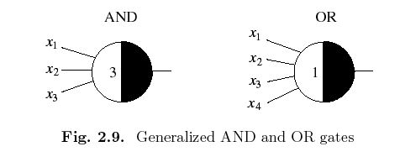
Threshold Logic

Slide 10
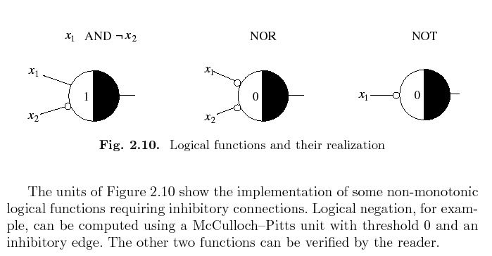
Threshold Logic

Slide 11
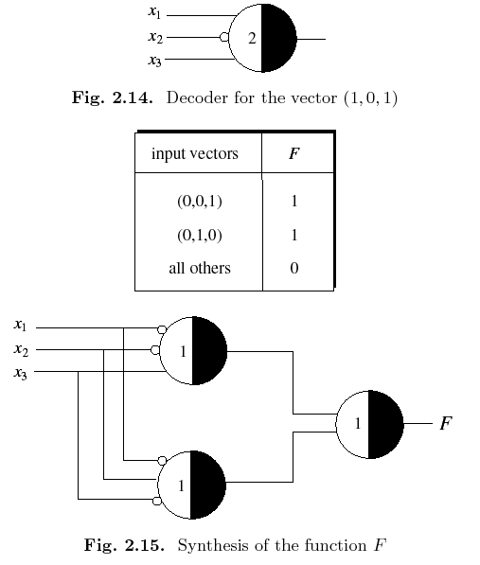

Slide 12
Weighted and Unweighted Networks
Since McCulloch–Pitts networks do not use weighted edges, the question of whether weighted networks are more general than unweighted ones must be answered.
A simple example shows that both kinds of networks are equivalent.
Assume that three weighted edges converge on the unit shown in Figure 2.17. The unit computes

Slide 13
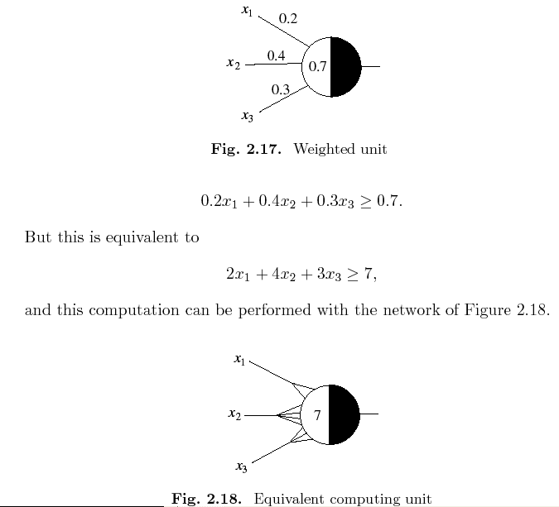

Slide 14
Perceptron
In the preceding slides, we arrived at the conclusion that McCulloch–Pitts units can be used to build networks capable of computing any logical function and of simulating any finite automaton.
Learning can only be implemented by modifying the connection pattern of the network and the thresholds of the units, but this is necessarily more complex than just adjusting numerical parameters.
For that reason, we turn our attention to weighted networks and consider their most relevant properties.

Slide 15
Perceptron
In 1958 Frank Rosenblatt, an American psychologist, proposed the perceptron, a more general computational model than McCulloch–Pitts units.
The essential innovation was the introduction of numerical weights and a special interconnection pattern.
In the original Rosenblatt model the computing units are threshold elements and the connectivity is determined stochastically. Learning takes place by adapting the weights of the network with a numerical algorithm.
Rosenblatt’s model was refined and perfected in the 1960s and its computational properties were carefully analyzed by Minsky and Papert.
In the following, Rosenblatt’s model will be called the classical perceptron and the model analyzed by Minsky and Papert the perceptron.

Slide 16
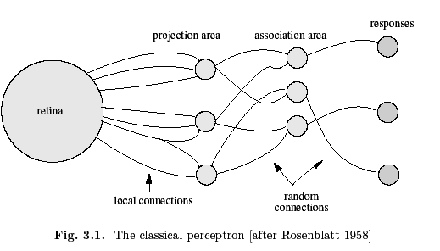
Perceptron

Slide 17
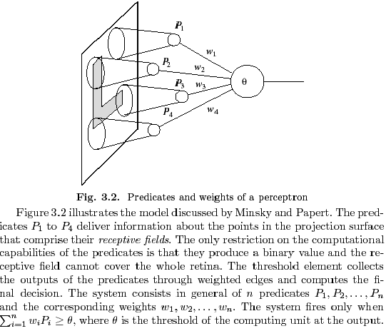
Perceptron

Slide 18
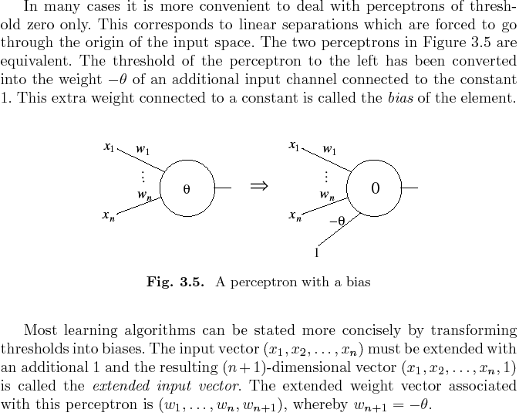

Slide 19
Perceptron:
Computational Limits
Early experiments with Rosenblatt’s model had aroused unrealistic expectations in some quarters, and there was no clear understanding of the class of pattern recognition problems which it could solve efficiently.
Minsky and Papert used their simplified perceptron model to investigate the computational capabilities of weighted networks.
They found that perceptrons are only capable of learning linearly separable patterns.
Theorem (Minsky and Papert, 1969): The perceptron rule converges to weights that correctly classify all training examples provided the given data set represents a function that is linearly separable.

Slide 20
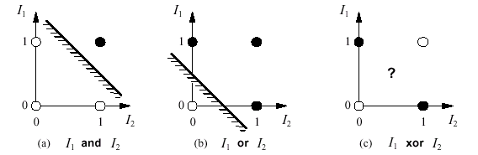
Linear separability:
Perceptron:
Computational Limits

Slide 21
Perceptron: Conclusion
The perceptron was the first neural network to be produced commercially, although the first prototypes were used mainly in research laboratories.
Frank Rosenblatt used the perceptron to solve some image recognition problems.
Some researchers consider the perceptron as the first serious abstract model of nervous cells.

